Slide 1
CSE 11
Accelerated Intro to Programming Discussion Section 4
Sachin Deshpande
Summer 1 2021
This discussion is being recorded

Slide 2




Logistics
PA3 is due today
PA4 released today
Resubmissions!

Slide 3
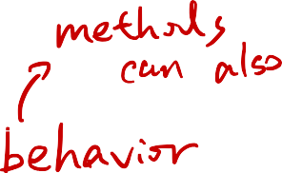



























Interface
Classes that share behavior
An interface is declared by using the interface keyword
all the methods in an interface are declared with the empty body, For Example-
interface /* Interface Name */ {
/* Method Signature */;
/* Method Signature */;
/* ... */
}
classes and abstract classes can implement interfaces with the following syntax -
class /* Class Name */ impleme
nts /* Interface Name */ {
/* ... */
}
interface allowed us to treat multiple classes as a shared type, For Example - We use it to create Unions of regions without worrying about what the underlying Region type actually was
All methods in interface are implemented

Slide 4
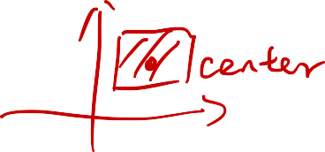


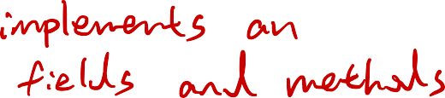




























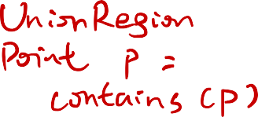




Example:
interface Region {
boolean contains(Point p);
}
class SquareRegion implements Region {
...
public boolean contains(Point toCheck) {...}
}
class CircleRegion implements Region {
...
public boolean contains(Point toCheck) {... }
}
class UnionRegion { Region r1, r2;
UnionRegion(Region r1, Region this.r1 = r1;
this.r2 = r2;
}
public boolean contains(Point p) {
r2) {
return this.r1.contains(p) || this.r2.contains(p);
}
}

Slide 5





















Tester
import tester.*;
tester.jar – java archive
Libraries that contain classes that we can use in our own code
Tester
Tester class allows us to create methods to unit test our code
Unit testing – compare actual values versus expected values
t.checkExpect(<actual value>, <expected value>);
test method name should begin with “test”
Goal: get all tests to pass
Confidence that your code/solution is correct

Slide 6
Tester
import tester.*; class Test1 {
int method1() {}
//week1 - test as a single method to a field
int field1 = this.method1();
//wed of Week2
boolean testMethod1(Tester t) {
return t.checkExpects(this.method1(), 1);
}
//week 3 after we discuss main()
void testMethod2(Tester t) {
t.checkExpects(this.method1(), 1);
} }

Slide 7
PA4
Different assignments in this course have different collaboration policies. On this assignment, you cannot share code publicly on Piazza or with any other students in the course. If you need to share code, ask in a private Piazza post or in 1-on-1 hours. Still do ask any public code questions about lecture code, quizzes that are past, or other conceptual questions, just no code from this PA.

Slide 8
Thanks!

